Slide 1
ENDOCRINE SYSTEM REVIEW
HUMPHREY M.
BSC.N.

Slide 2
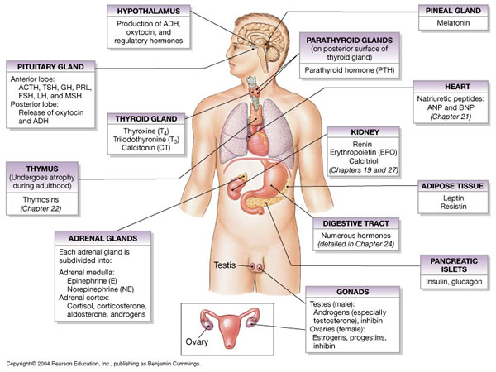

Slide 3
ANATOMICAL & PHYSIOLOGICAL CONSIDERATIONS
Each person has two adrenal glands, one attached to the upper portion of each kidney, i.e the left and right.
The adrenal medulla at the center of the gland secretes catecholamines, and the outer portion of the gland, the adrenal cortex, secretes steroid hormones.

Slide 4
THE ADRENAL CORTEX
The secretion of hormones from the adrenal cortex is regulated by the hypothalamic–pituitary–adrenal axis.
The hypothalamus secretes corticotropin-releasing hormone (CRH), which stimulates the pituitary gland to secrete ACTH, which in turn stimulates the adrenal cortex to secrete glucocorticoid hormone (cortisol).
Increased levels of the adrenal hormone CORTISOL then inhibit he production or secretion of CRH and ACTH.

Slide 5
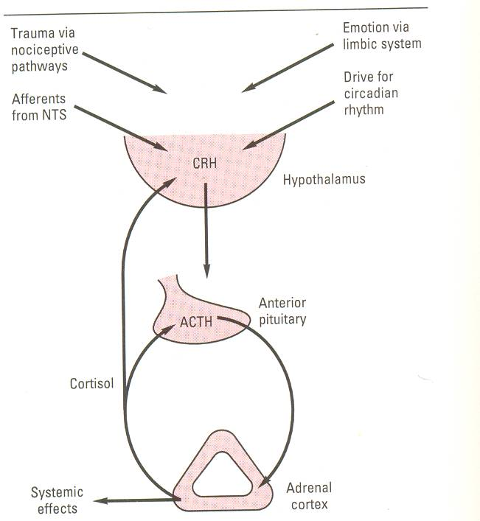
3.2.

Slide 6
THE ADRENAL CORTEX HORMONES
Steroid hormones produced by the adrenal cortex are
Glucocorticoids e.g hydrocortisone;
Mineralocorticoids, mainly aldosterone;
Sex hormones, mainly androgens (male sex hormones).
Survival in the absence of a functioning adrenal cortex is possible only with nutritional, electrolyte, and fluid replacement and appropriate replacement with exogenous adrenocortical hormones.

Slide 7
Effects of Glucocorticoids e.g Cortisol
Stimulates gluconeogenesis-conversion of non-carbohydrates e.g amino acids into glucose in the liver.
Mobilization of protein from extra hepatic tissue mainly muscles into free glucose in blood.
Decrease glucose utilization by the cells
Elevates blood glucose concentration i.e. adrenal diabetes.
Mobilization of lipids from their stores into free glucose
Anti-inflammatory activity

Slide 8
QUESTIONS TO THE CLASS…???
Q/N1: WHAT STIMULATES THE RELEASE OF HORMONE ALDOSTERONE??????????
Q/N2: WHAT ARE THE EFFECTS OF HORMONE ALDOSTERONE??????????????

Slide 9
THE ADRENAL MEDULLA
Functions as part of the autonomic nervous system
Stimulation of sympathetic nerve fibers, which travel directly to the cells of the adrenal medulla, causes release of the catecholamine hormones epinephrine and norepinephrine.
About 90% of the secretion of the human adrenal medulla is epinephrine (a.k.a adrenaline).
TASK: REVIEW THE EFFECTS OF SYMPATHETIC STIMULATION

Slide 10
Sympathetic N.S.-Adrenal Medulla-Catecholamines
Norepinephrine increase myocardial excitability, causing extra systoles and may cause more serious heart problems.
Norepinephrine-cause vasoconstriction in most if not all organs
Catecholamines are produced by adrenal medulla.
They increase allertness,cause Glycogenolysis, increase BMR
Its under neural control-increased secretion as part of sympathetic discharge provoked in emergency situation –emergency function of the sympathoadrenal system

